Slide 1
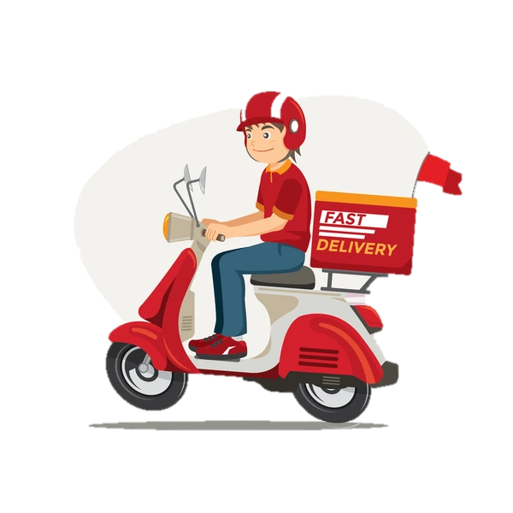
Zomato Sales Analysis
By Abhilash Kukade

Slide 2
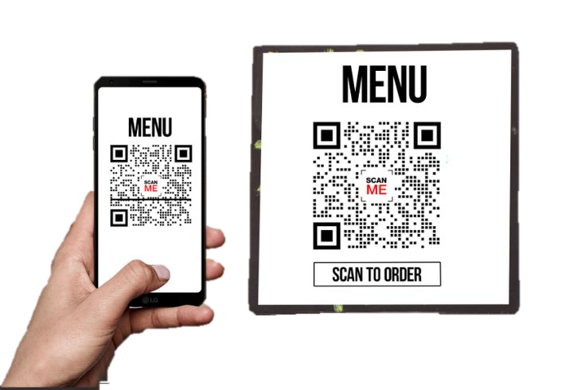
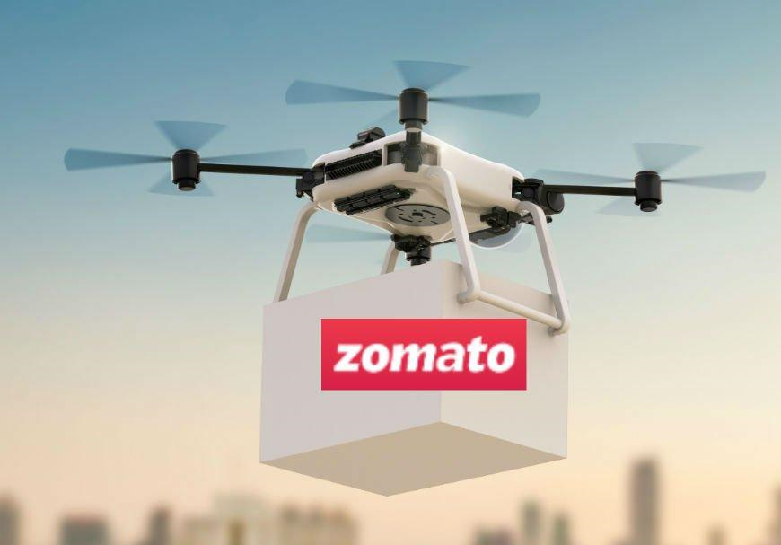
ABOUT ZOMATO From Menu Scans to Food Tech Giant
Zomato started in 2008 as "Foodiebay," a simple platform for scanning and uploading restaurant menus. Today, it's a global food delivery and restaurant discovery powerhouse operating in over 20 countries!
Zomato made headlines in 2019 by testing drone food deliveries, showcasing its commitment to innovation and futuristic food delivery experiences.

Slide 3
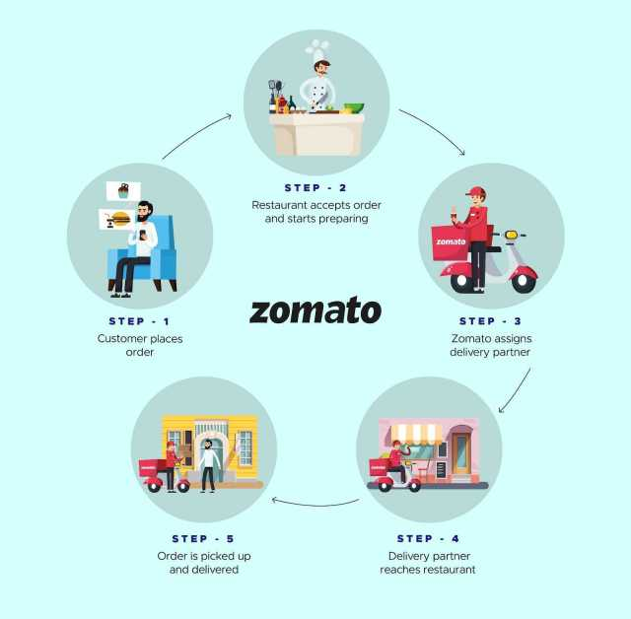
How works

Slide 4
Data Overview
Dataset Source: Zomato restaurant data across 20+ countries
Scope: Restaurant name, location, cuisine, cost, delivery, rating, etc.
Size: ~9,500 records, 249 cuisines, 140 cities
Data Cleaning
Removed duplicates
Standardized labels
Converted cost to INR
Why It Matters
Reveals global dining trends
Supports expansion planning with real data

Slide 5
What We Aim to Solve
The Core Question
Where should Zomato expand to maximize growth and customer satisfaction?
Our Goal
Identify countries with high ratings & low competition
Target cities with high spend & fewer restaurants
Expand delivery and booking to improve experience

Slide 6
Our Analytical Process
Used Pivot Tables and Excel Data Model for performance
Slicers for Year and Country to enable dynamic filtering
Calculated KPIs like:
Total restaurants
Distinct countries
Average cost and rating
Created visual charts and used GETPIVOTDATA() for stable KPI cards

Slide 7
Dashboard Charts - No. of Restaurants Available
Key Observations:
🇮🇳 India leads with 8,642 listings — 90% of total
🇺🇸 USA and 🇬🇧 UK show moderate presence (425 and 80)
Smaller countries (Qatar, Sri Lanka, Indonesia) have low competition — ideal for expansion
Recommendations:
Focus expansion efforts on low-saturation countries with high ratings
In India, shift from quantity to quality and service innovation

Slide 8
Dashboard Charts - TOP 10 CUISINES BY POPULARITY AND RATING
Key Insights:
North Indian tops with 3,953 listings
Chinese & Fast Food are widely available
Cafe, Bakery, and Desserts have steady presence
Recommendation:
Focus expansion on top 3 cuisines
Promote niche cuisines in select regions

Slide 9
Dashboard Charts – ANNUAL GROWTH OF RESTAURANT
Key Takeaways:
Growth peaked in 2018 (1,101 restaurants)
Dip from 2012–2016, lowest in 2012
Recovery trend steady since 2017
Actionable Insight:
Replicate post-2016 onboarding strategies
Analyze 2012–2016 slowdown causes
Align planning & campaigns with growth phases

Slide 10
Dashboard Charts - AVERAGE RATING IN COUNTRIES
Key Takeaways:
🇵🇭 Philippines (4.44), 🇮🇩 Indonesia (4.33), 🇹🇷 Turkey (4.28) lead in customer satisfaction
🇮🇳 India (2.93) has the lowest average rating
Most countries fall between 3.5–4.2, indicating moderate satisfaction
Actionable Insight:
Improve service quality in India & Singapore
Prioritize expansion in high-rating markets
Leverage ratings for quality control & localization strategy

Slide 11
Dashboard Charts - HAS TABLE BOOKING
Key Takeaways:
Only 12% (1,158 of 9,532) offer table booking
Majority (8,374) lack reservation options
Highlights a service gap in advance booking
Actionable Insight:
Promote table booking to improve dine-in experience
Highlight booking-enabled restaurants in the app
Run user study to gauge demand and refine onboarding

Slide 12
Dashboard Charts - HAS ONLINE DELIVERY
Key Takeaways:
Only 26% (2,451 of 9,532) offer online delivery
74% still lack delivery options
Online delivery remains underutilized despite digital growth
Actionable Insight:
Incentivize non-delivery restaurants to enable delivery
Feature delivery-enabled outlets more prominently
Support traditional restaurants in adopting delivery tech

Slide 13
Dashboard Charts - AVERAGE COST OF TWO COUNTRY-WISE
Key Takeaways:
Singapore (₹12,687) & Philippines (₹11,217) have highest average costs
Turkey (₹216) & Sri Lanka (₹650) are most affordable
India (₹708) is well below global average (₹933) — a cost-sensitive market
Actionable Insight:
Tailor pricing & promotions by region
Explore affordable formats in high-cost markets
Use data to drive menu localization & dynamic pricing

Slide 14
Top Countries for Expansion
Criteria:
Restaurant Count < 100
Rating > 4.2
Avg. Cost for 2 < ₹4000
Selected Countries:
Indonesia, Turkey, South Africa, New Zealand, UAE
Visual: Bar Chart - Avg. Rating vs. Country
Takeaway:
These countries offer high customer satisfaction with less market saturation.

Slide 15
Impact of Online Delivery & Table Booking on Customer Ratings
Key Observation:Both delivery and booking improve ratings, but booking alone makes a big impact.
Takeaway:
Ratings rise from 2.7 → 3.4 when only booking is added, even without delivery. Digital services = better customer satisfaction.

Slide 16
Cuisine Pricing vs. Rating
Correlation Value: Based on the data, there is a weak positive correlation (R² = 0.0777) between pricing and ratings
Interpretation:There is only a slight connection between higher pricing and higher customer ratings. Cost explains just 7.8% of rating variation.
Takeaway:Pricing alone doesn’t drive satisfaction. Food quality, service, and variety are more influential.

Slide 17
Cuisines to Focus On
Popular & Highly Rated Cuisines:
Italian, Mexican, South Indian, Turkish, Japanese
Cuisine Category Mapping:
Grouped 249 cuisines into ~15 major categories for analysis
Visual: Pie Chart - Top Cuisine Categories
Takeaway:
These cuisines show consistent high performance across geographies.

Slide 18
Competition Mapping
Cities were grouped by restaurant volume and 4.5+ rating % into 3 segments
127 cities fall under Medium Potential – a majority of global markets are moderately competitive
9 cities offer high ratings with low restaurant count – ideal for expansion
Only 4 cities are in the Low Potential group – low satisfaction despite density
City | Total_Restaurants
London | 20
Taguig City | 4
Inner City | 2
Pasig City | 3
Makati City | 2
Lincoln | 1
Beechworth | 1
Tagaytay City | 1
Quezon City | 1

Slide 19
Strategic Recommendation - Expansion Markets
Recommended Countries:
Indonesia, Turkey, New Zealand, South Africa, UAE
Rationale:
Avg Rating ≥ 4.2
Low competition
Value-driven pricing
Untapped digital delivery
Expansion:
Early mover advantage
Digital-first model ready
Strong customer-fit markets

Slide 20
Strategic Recommendation - Operational Focus
Recommendation:
Expand online delivery & table booking in all markets
Why?:
No services → 2.82 rating
With both → 3.63 rating
Digital access boosts experience
Impact:
Higher satisfaction & visibility
More reviews, repeat visits
Improved customer loyalty

Slide 21
Strategic Recommendation - Menu & Pricing
Menu Strategy:
Strong cost–rating correlation (R² = 0.78)
Premium cuisines (e.g., Sushi, BBQ) rate higher
Insight:
Customers link price with quality
Higher prices = better feedback for known cuisines
Impact:
Avoid underpricing premium items
Price based on perceived value
Upsell high-rated, high-margin categories

Slide 22
Summary & Strategic Recommendations
Dashboard allows filtering by Country and Year
Easy to identify:
Underserved cuisines and cities
Opportunities to expand delivery or booking features
Markets with price–rating mismatches
Stakeholders can:
Expand where competition is low
Prioritize high-rated cuisine investments
Balance affordability with service offerings

Slide 23
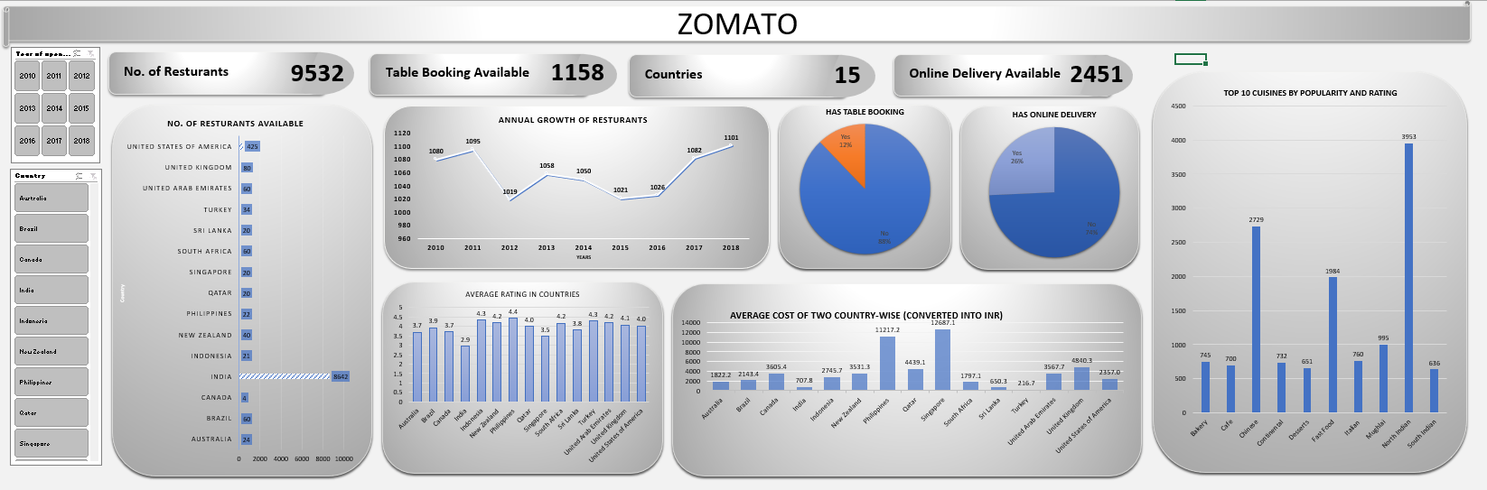
Final Interactive Dashboard

Slide 24
THANK YOU

